Slide 1

Rapido Platform Simulation
A Robust Ride Management System Backend in C
Developed by: Ravi Kumar & Harshavardhan
Data Structures & Algorithms Project

Slide 2


Project Vision
System Overview
The Rapido Platform Backend is a software simulation designed to handle high-frequency ride-hailing requests efficiently. It serves as a foundational architectural model for transport aggregators.
Dynamic ride booking and queue management.
Efficient resource allocation via memory pointers.
Scalable backend logic for urban mobility.

Slide 3
The Problem Statement
Limitations of Arrays
Conventional systems using static arrays suffer from critical bottlenecks in ride-hailing scenarios:
100%
Memory Wastage: Fixed-size arrays reserve space even when idle.
System Overflow: Inability to handle requests beyond predefined limits.
Static Constraint
Operational Rigidity: Costly shifting of data during ride cancellations.

Slide 4


Real-world Impact
In mega-cities, platforms like Rapido and Uber process millions of events. Our project mimics the core logistical engine that powers these services.
Use Cases: Bike-taxis, on-demand logistics, real-time fleet tracking, and dynamic fare estimation engines.

Slide 5

Data Structure Chosen
Singly Linked List (SLL)
The platform is anchored on the Singly Linked List architecture, providing unparalleled flexibility for ride data.
Dynamic Nodes: Every ride booking is an independent memory node.
Runtime Allocation: Memory is claimed only when a booking is made.
Seamless Deletion: Ride completion frees memory with O(1) pointer adjustment.

Slide 6






System Architecture
Modular Layer
Heap Logic
Memory Safety
Independent functions for each CRUD operation to ensure clean code and high maintainability.
Bypassing the stack to utilize heap memory for persistent data during the program session.
Strict implementation of explicit deallocation loops to prevent memory leakage on exit.

Slide 7
The CRUD Algorithm
Operation | Algorithmic Logic | Efficiency
Create | Dynamic Node Allocation + Tail Linkage | O(n)
Read | Sequential List Traversal to NULL | O(n)
Update | Linear Search + Attribute Modification | O(n)
Delete | Predecessor Rerouting + Memory Free | O(n)

Slide 8

Code Implementation
Technical Stack
Language: ANSI C (Low-level Control)
Memory: malloc(), free()
Node Definition
Logic: Self-referential Structures
UI: Menu-driven Switch Interface

Slide 9






System Operations Demo
Add_Ride.exe
Display_All.exe
Search_ID.exe
$ Enter Ride ID: 101
ID | NAME | FARE
$ Search ID: 102
101 | Ravi | 450.0
$ Customer: Ravi
102 | Harsh | 320.0
Result: Found Harsh
$ Fare: 450.00
-- End of List --
Dest: Central Park
[SUCCESS] Node created at 0x55a1...
Update.exe
Delete_Node.exe
$ Update ID: 101
$ Delete Ride ID: 101
$ New Fare: 500.00
Unlinking node 101 from head...
[OK] Data Synchronized
[FREE] Memory block 0x55a1 released back to OS.

Slide 10
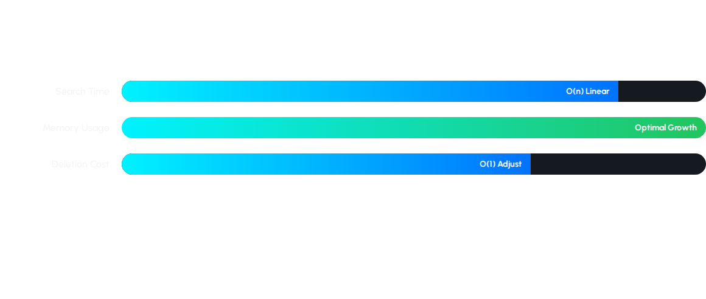
Performance Metrics
Linked Lists balance memory conservation with linear performance, outperforming arrays in dynamic environments.

Slide 11


Backend Execution
The console interface provides a clean menu for ride management.
> 1. Add Ride > Enter ID: 101 > Success: Ride Allocated > 2. Display All > Rahul | Airport | $450
Real-time interaction with the memory heap.

Slide 12
Project Evolution
Sorting
Persistence
Security
GUI
Fare-based sorting algorithms
File I/O log generation
Admin authentication
Frontend integration

Slide 13


Thank You
Ravi Kumar & Harshavardhan
Any Questions?

